Slide 1

CMake Training Session 2 More Advanced CMake
Jamie Smith

Slide 2
Intro: A Short History of CMake
2000: Kitware contracted to develop a new build system for a bioinformatics program called ITK: a Cross-platform Make
Had to be able to read in a buildscript in a single format and generate Makefiles for Linux and Visual Studio project files for Windows
Needed to support complex configurations, 3rd party libraries, and custom commands which generates source files
The CMake of the early 00s was very different from what we know today. It used an almost completely different set of commands, most of which operated at the global scope
2006: KDE switches its entire build system to CMake. Many other open-source projects begin to follow suit over the next few years.
2014: CMake 3.0 is released, introducing many of the features we use as standard today.
More good info: https://www.aosabook.org/en/cmake.html

Slide 3
Part 1
Targets and Properties

Slide 4
What is a target?
A target is anything that CMake can build:
Static library

Slide 5
Part 2
Build Types and Compile Flags

Slide 6
The Weirdness that is Cache Variables
Like all build systems, CMake provides a way for you to pass command line options that affect the build system’s behavior
It’s also desirable to have a way to store the results of different tests so the buildscript runs faster when you run it subsequent times
For CMake, both of these are achieved through the same mechanism: cache variables
Cache variables are special variables that keep their values between invocations of CMake

Slide 7
Creating Cache Variables
Cache variables are created using an alternate signature for set().
Signature: set(<variable> <value>... CACHE <type> <docstring> [FORCE])
CACHE keyword argument specifies cache signature
Type specifies the type of data that will be stored in the variable.
Possible values: BOOL, FILEPATH, PATH, STRING, INTERNAL
Docstring is the comment that will be attached to the variable in the cache
If FORCE is given, the variable’s value will be overwritten. Otherwise it will not be modified if it already exists
Why is this?

Slide 8
Command Line Options
Cache variables can also be set on the command line using –DMY_CACHE_VAR=<value>
Intention is for set(CACHE) to be used to initialize an option with a default value, and then the user can override it on the command line
However, sometimes scripts need to store data even though it isn’t a settable option. This is what the INTERNAL type, which hides the variable from the user, is for

Slide 9
Viewing Cache Variables
Cache variables can be viewed and edited by:
Editing CMakeCache.txt
Using the ccmake tool
Using the cmake-gui tool
The intention was for these to provide a user-friendly interface for configuring CMake projects
However, 95% of users don’t know these exist, so developers don’t usually spend time making them clean and usable, so people rarely use them
Bit of a chicken-and-egg problem…

Slide 10
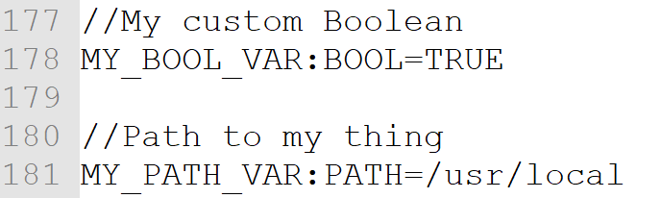
Cache Variable Example: CMakeCache.txt
<snip>

Slide 11
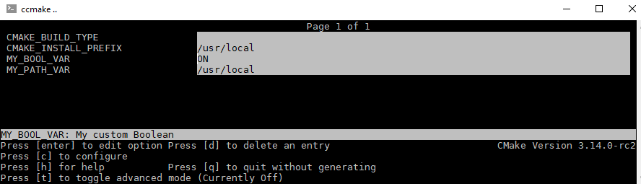
Cache Variable Example: ccmake

Slide 12
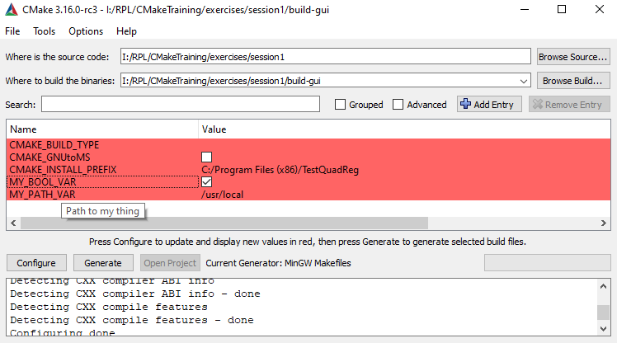
Cache Variable Example: cmake-gui

Slide 13
Cache Variable Overriding: A Cheat Sheet
This is one of the most confusing things in CMake by a large margin. Even I still mess it up.
If a _____ is defined, and you set a ____ with the same name, then…
local variable | local variable | The local variable’s value is changed.
cache variable | cache variable (without FORCE) | The cache variable’s original value is not changed
cache variable | cache variable (with FORCE) | The cache variable’s original value is overwritten
cache variable | local variable | The cache variable is shadowed while the local variable is in scope
local variable | cache variable | If the cache variable had already been created, then it stays out of scope. However, if the cache variable did not already exist, the local variable is deleted and the new cache variable is put into scope

Slide 14
Cache Variables Practice 1
What will it print?
-- Stuff will be installed to: /usr

Slide 15
Cache Variables Practice 2
What will it print?
-- Stuff will be installed to: /opt

Slide 16
Cache Variables Practice 3
What will it print?
The first time CMake is run:
-- Stuff will be installed to: /opt
Subsequent runs:
-- Stuff will be installed to: /usr

